Slide 1

Fast & Curious:
A πThon Speed Test
Ilias Xenogiannis
Ioannis Karakasis

Slide 2


Agenda
Time
Space

Slide 3
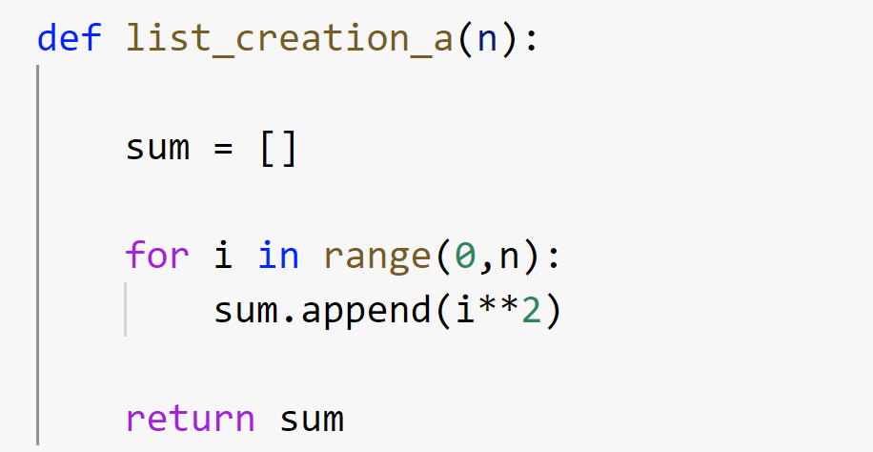
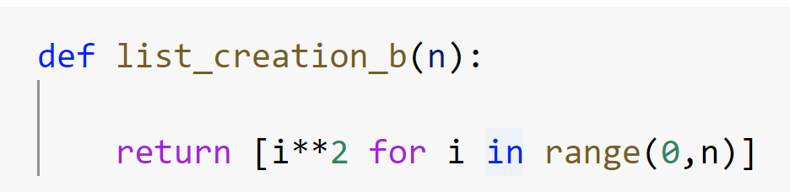
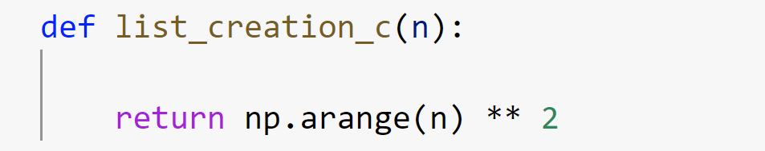
Creating a list
Append
Comprehension
Numpy
387 ms
370 ms
5.46 ms
x 1.04
x 70.87

Slide 4
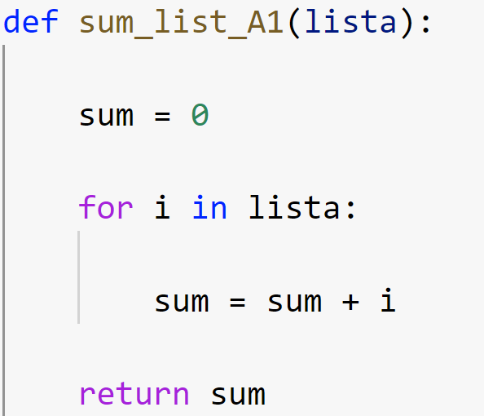
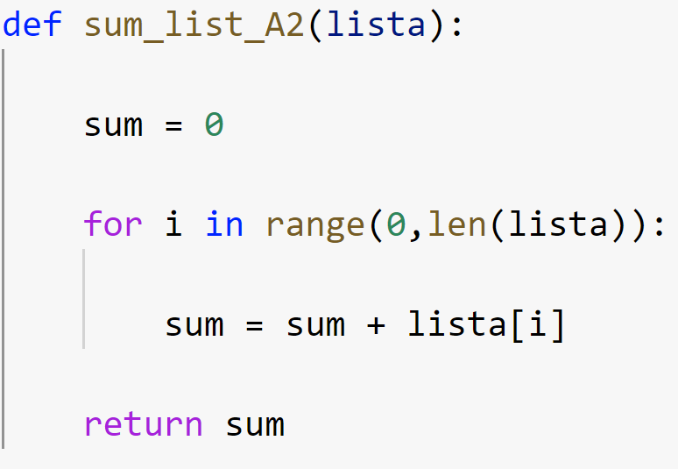
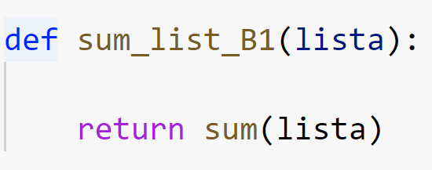
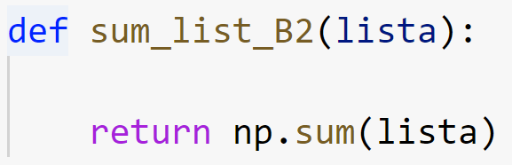
Summing a list
Index
In
Python Built In
Numpy
92.1 ms
58.1 ms
11.1 ms
1.3 ms
x 1.58
x 8.29
x 70.84

Slide 5
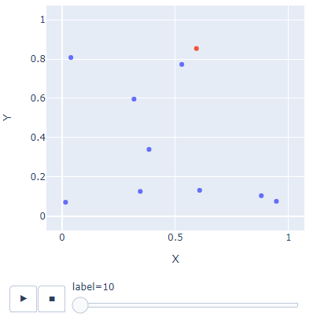
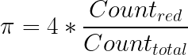
Monte Carlo

Slide 6
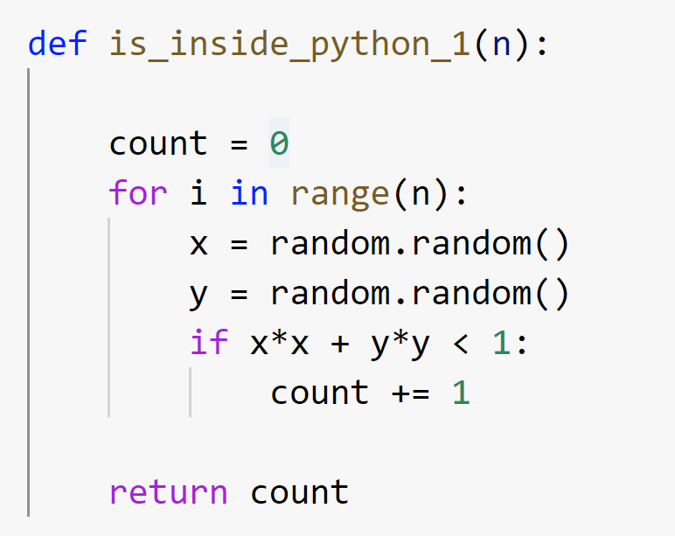
Monte Carlo Native Python
393 ms

Slide 7
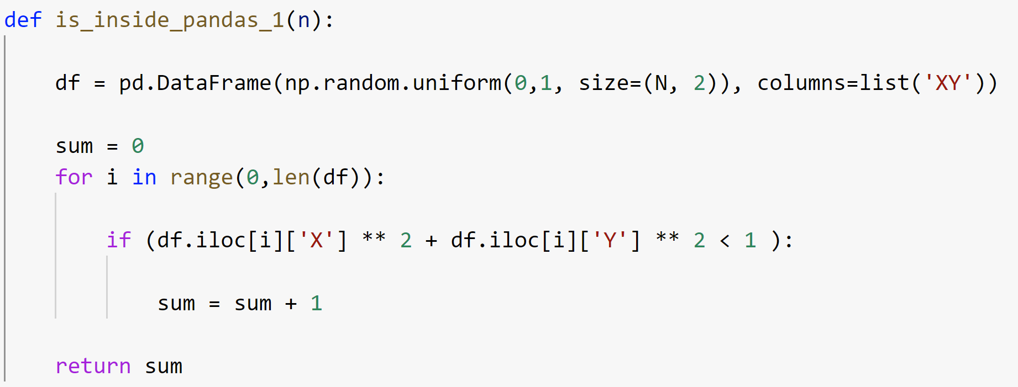
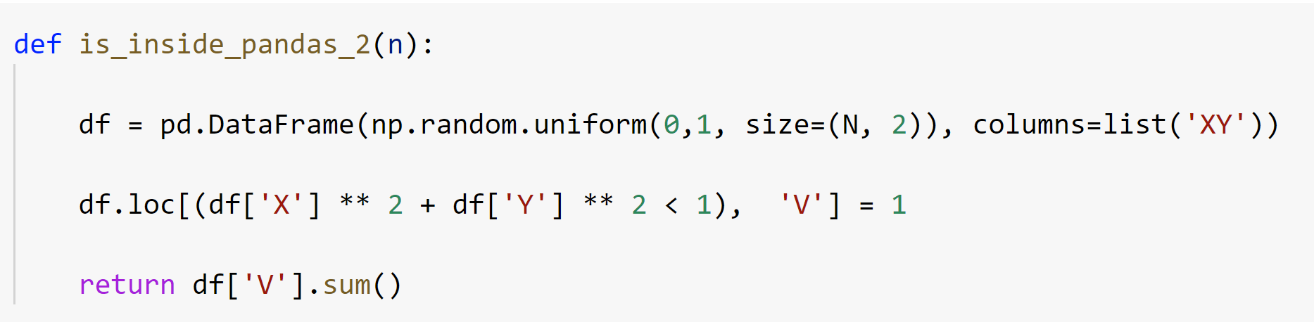
Monte Carlo Pandas
160000 ms
77.6 ms

Slide 8
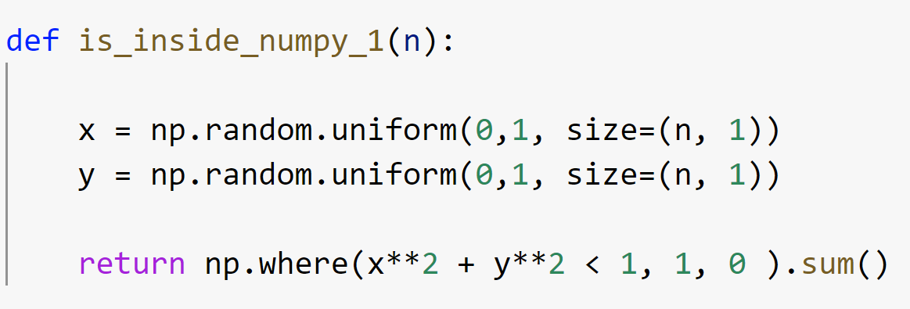
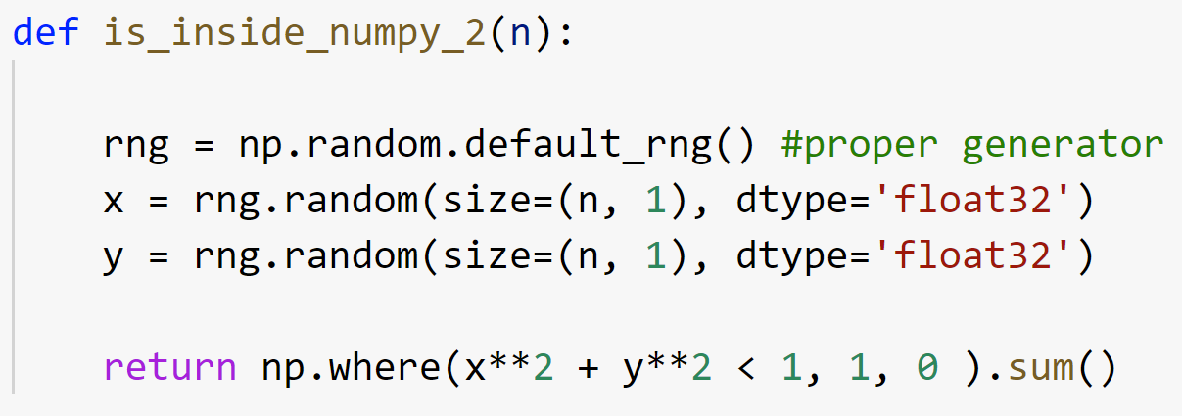
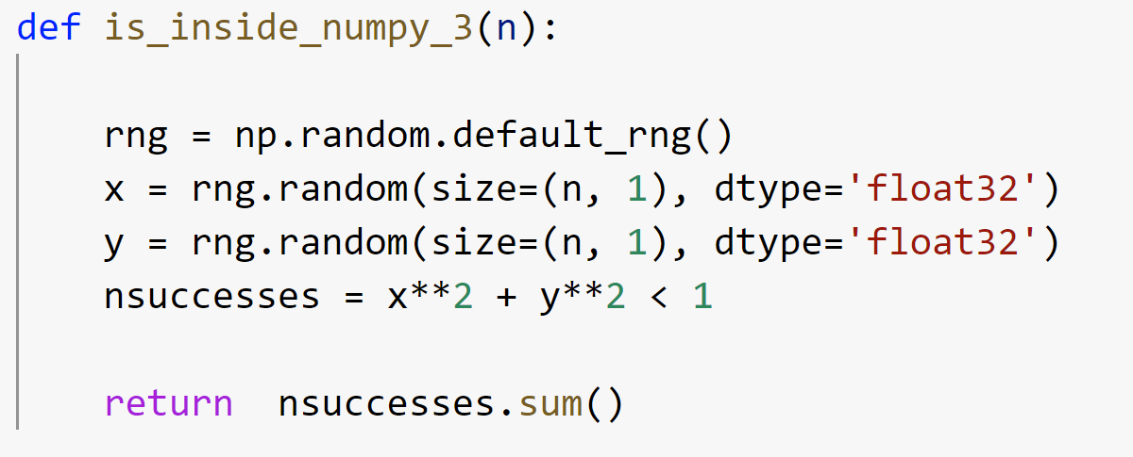
Monte Carlo Numpy
30.7 ms
15.6 ms
12.7 ms

Slide 9
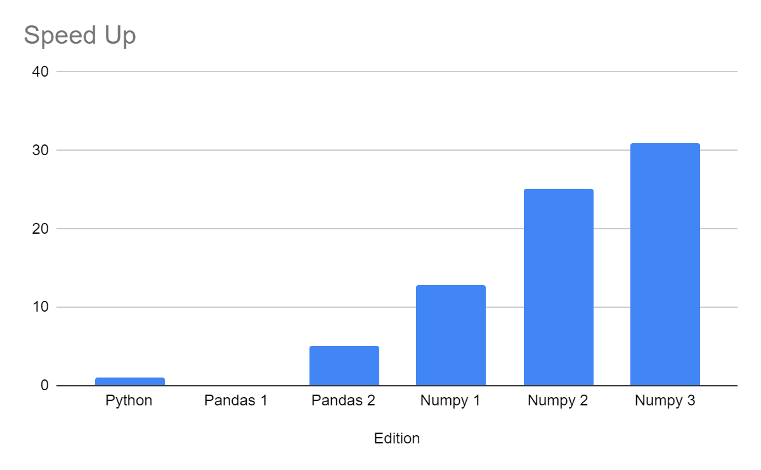
Monte Carlo Results

Slide 10


Is this all?

Slide 11
Multiprocessing

Slide 12
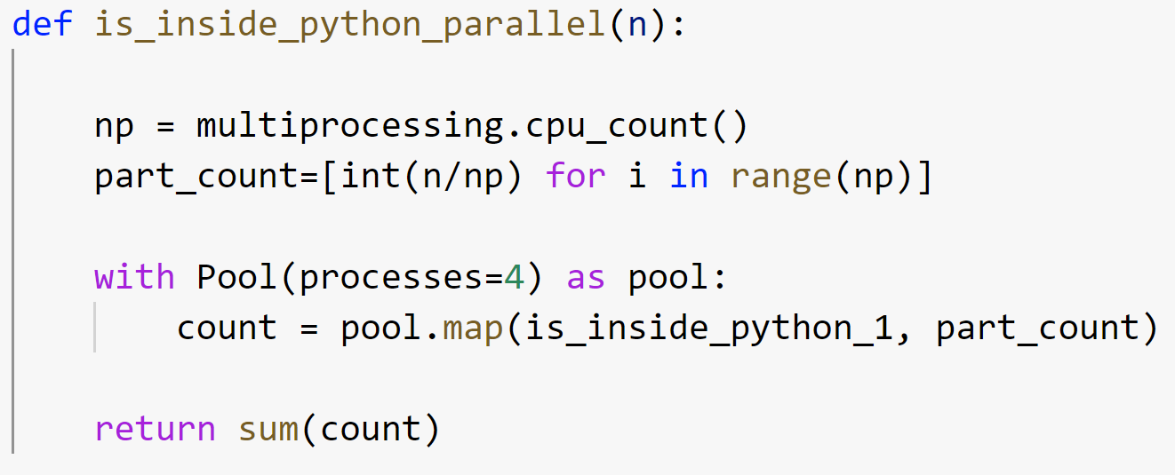
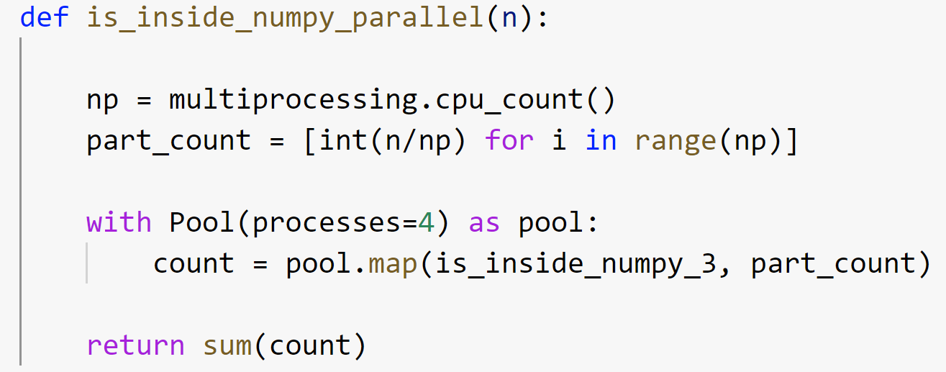
Multiprocessing

Slide 13
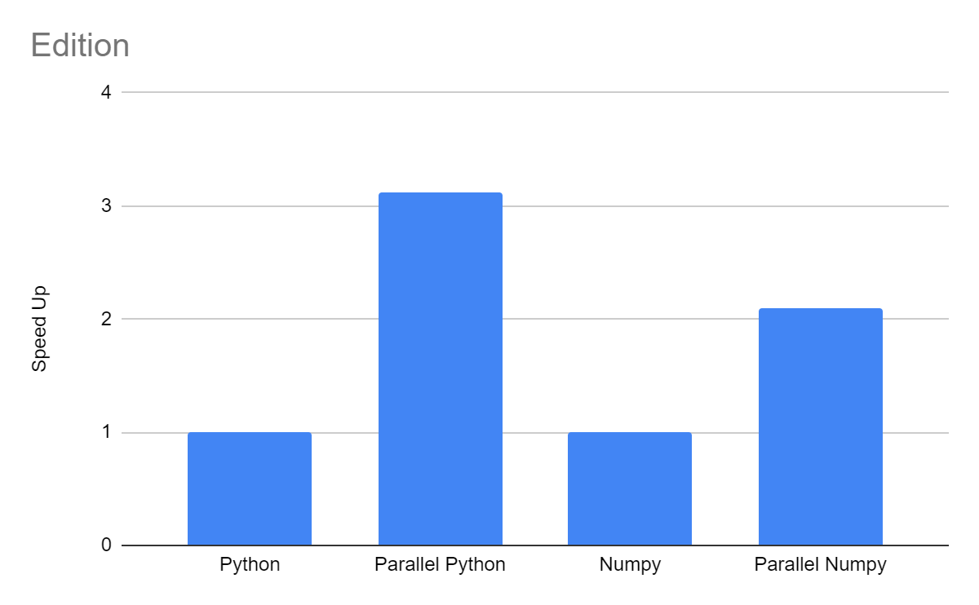
Results

Slide 14
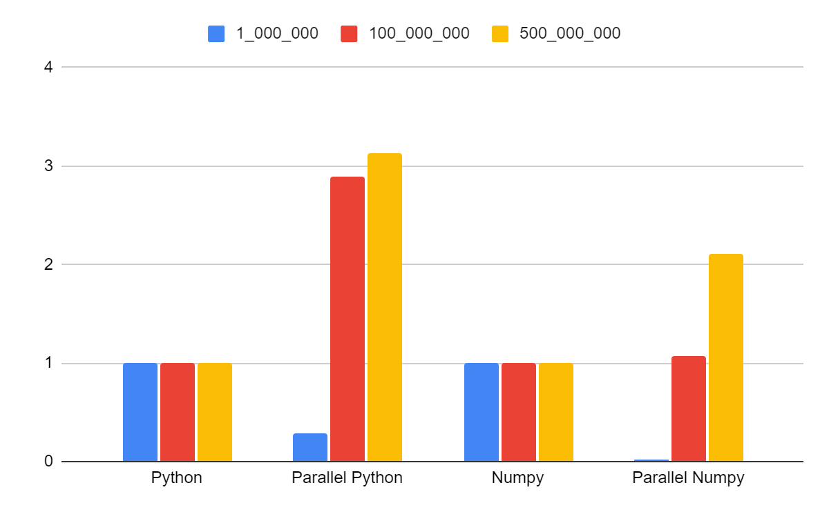
Results

Slide 15
One more thing...
Optimize the algorithm first
Premature optimization is the root of all evil
Respect your time more than the computers time
Be aware of the overhead!

Slide 16



Next Steps

Slide 17

Use Memory space efficiently

Slide 18
1st. A Stepback to the basics
Manage your data types
Use the most suitable file format
Use techniques to save memory space

Slide 19
Implementation level
Python Data Types
Numeric
Dictionary
Set
Boolean
Sequence
Integer
Float
Complex
Tuple
List
String

Slide 20
The truth about...
Python Data Types
Integers, floats...
Arrays, lists...
Implementation
Level
Flexibility
VS
Efficiency

Slide 21
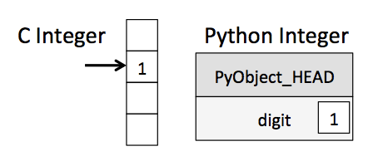
Storing an integer
Reference count
Type code
Size code
Actual Value

Slide 22
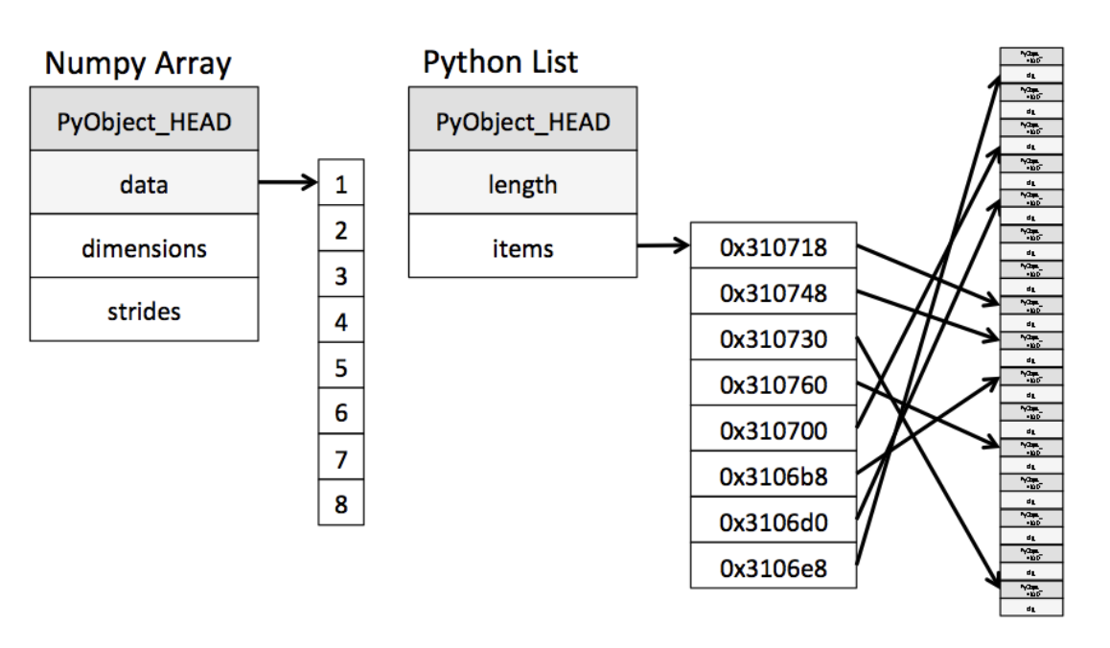
Implementation level

Slide 23
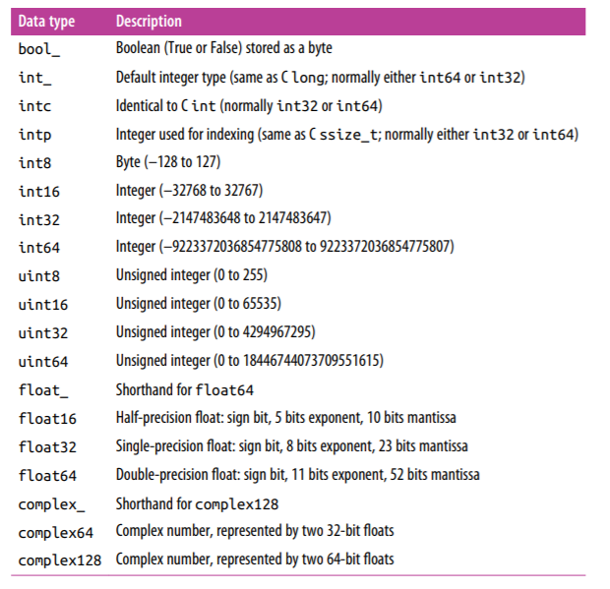
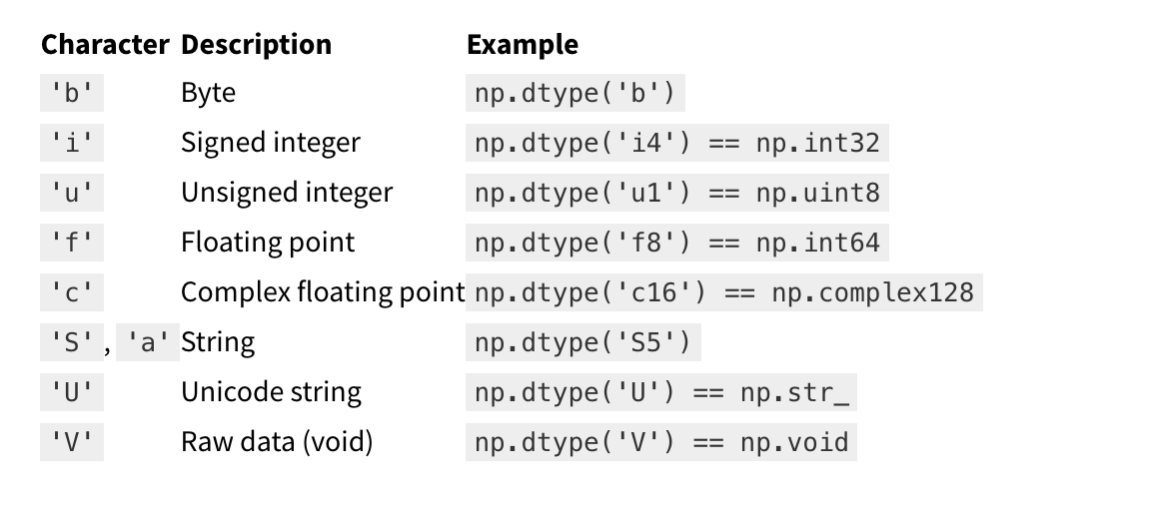
Numerical Subtypes
Must check the implementation of floating points. Notice anything weird in some fractions?

Slide 24
Numerical Subtypes
memory usage | float | int | uint | datetime | bool | object
1 byte |  | int8 | uint8 |  | bool
2 bytes | float16 | int16 | uint16
4 bytes | float32 | int32 | uint32
8 bytes | float64 | int64 | uint64 | datetime64
variable |  |  |  |  |  | object

Slide 25

Lists, Tuples & Sets
Important for Computationally expensive projects!
Tuples
&
Sets
are FASTER than
Lists

Slide 26
Internal Representation of DataFrames
Index Block
Object Block
Float Block
Blocks don’t maintain references to column names
Blockmanager Class
Categorical data

Slide 27
High Performance!
A glimpse of Collections module
Collections → containers that are used to store collections of data such as list, dict and set.
Counter
defaultdict
In: Iterable
Out: Counter Dictionary
Optimized version of a dictionary
deque
namedtuple
Optimized version of queue
Tuple with fixed names

Slide 28
Some Best Practices
Use Ravel / Reshape technique when using Numpy,
Use slots when defining a Python Class,
Use heapy for memory leaks
Select type while reading, by removing the date column
Next step...

Slide 29
Efficiency & File Formats
csv:
Spreadsheet file format
txt:
Plain Text (Unstructured)
xlsx:
XML file format
xml:
Human & Machine readable
json:
Designed for transmitting structured data
zip:
Archive file format
HDF:
Independent of size & type of system

Slide 30
Manage to fit in Memory (RAM)
Lossless
Lossy
1
Compression
2
Chunking
Need to process all data but not at once
3
Indexing
Chunking → Filtering

Slide 31
Compression
Lossless
Lossy
Dropping Columns
Lower-range numerical dtypes
Categorical Data
Sparse Columns
Changing numeric column representation
Sampling

Slide 32

Chunking
Separate elements into smaller groups
Code that reads data / coded that processes data
Used in NLP (stemming / lemmatization)
As long as each chunk fits in memory, on can work with datasets that are much larger than memory.
Strategy for improving performance by using knowledge of a situation to aggregate related memory-allocation requests.
Works better when zero coordination between chunks is required.

Slide 33
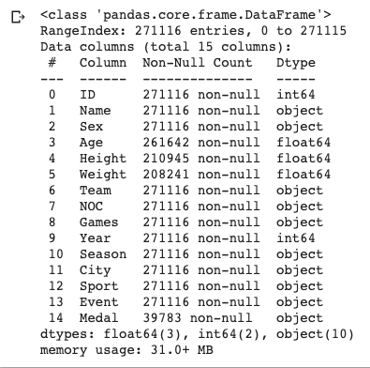
Test Dataset
Now we are ready to test it!

Slide 34
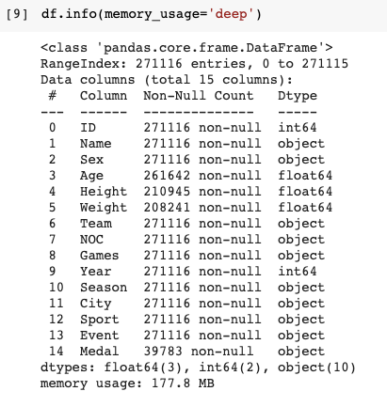
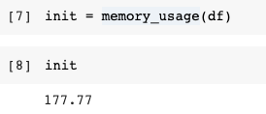
Select type while reading...

Slide 35
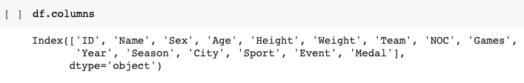
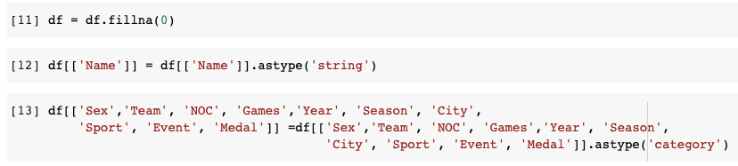
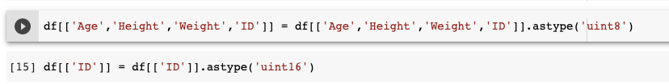
Select type while reading...

Slide 36
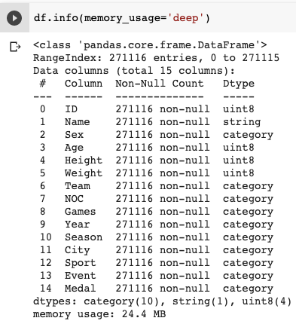
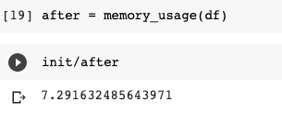
Before
VS
After

Slide 37


ABOUT US
John Karakasis
Ilias Xenogiannis
linkedin.com/in/john-karakasis
linkedin.com/in/ilias-xenogiannis
medium.com/@ixeno

